Slide 1

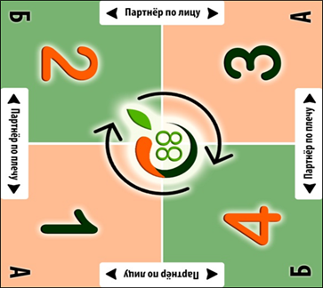
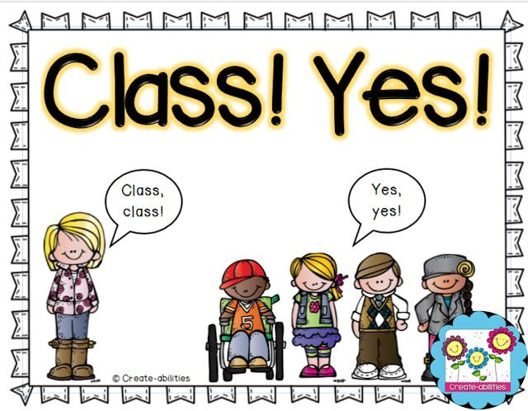

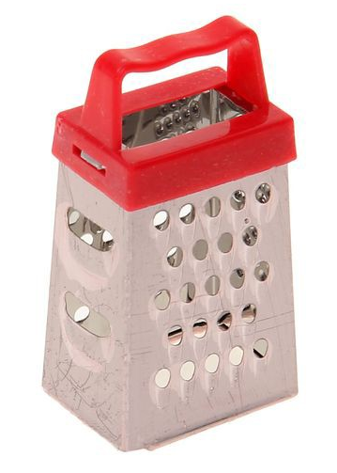



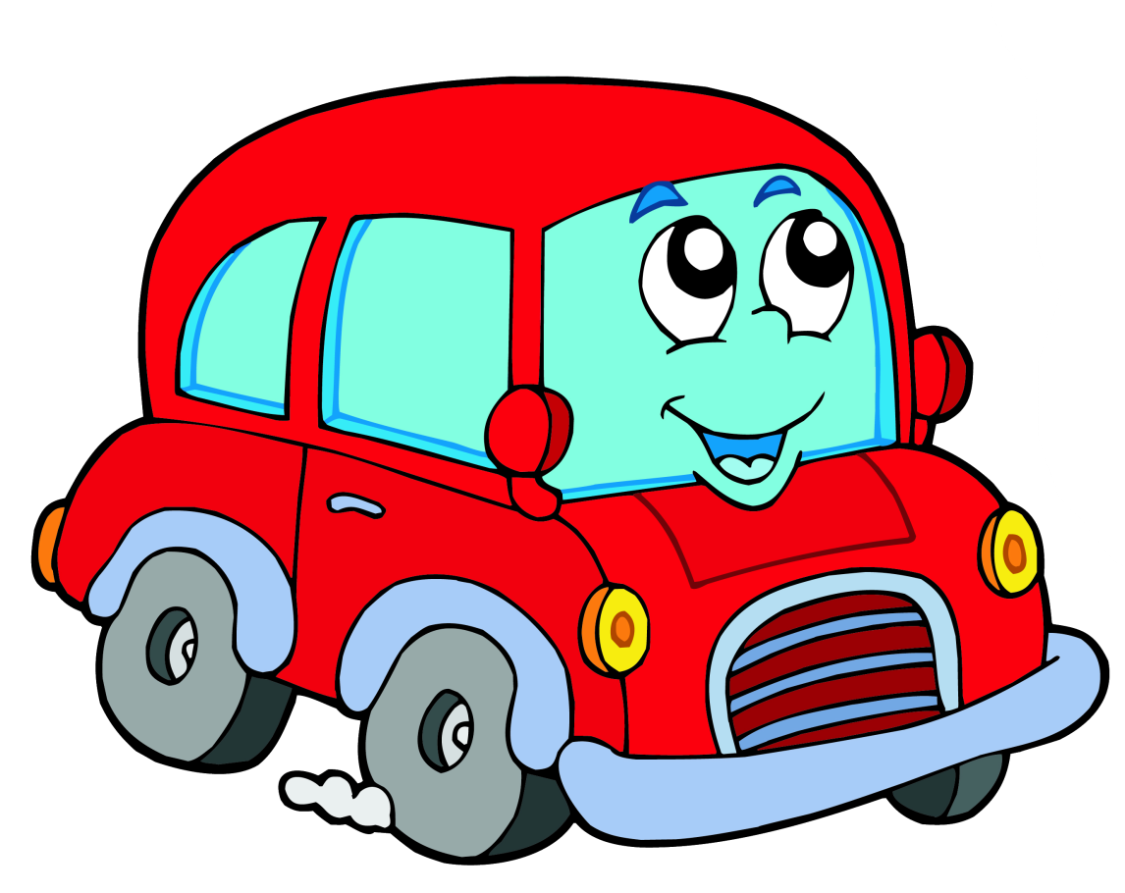
PARKING
GRATER
GREAT

Slide 2
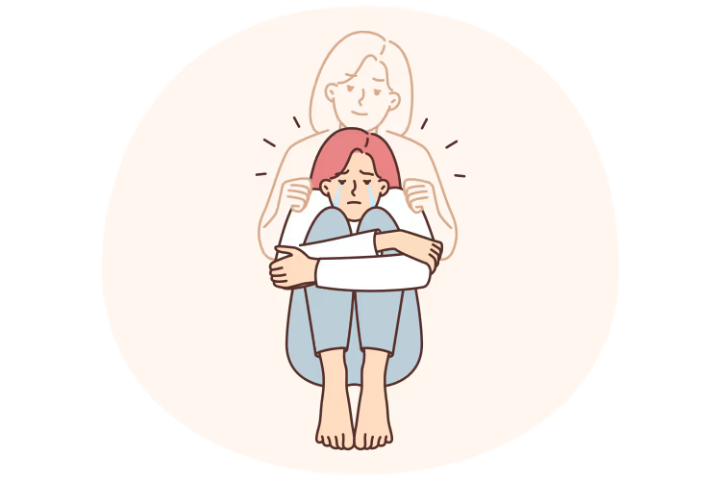

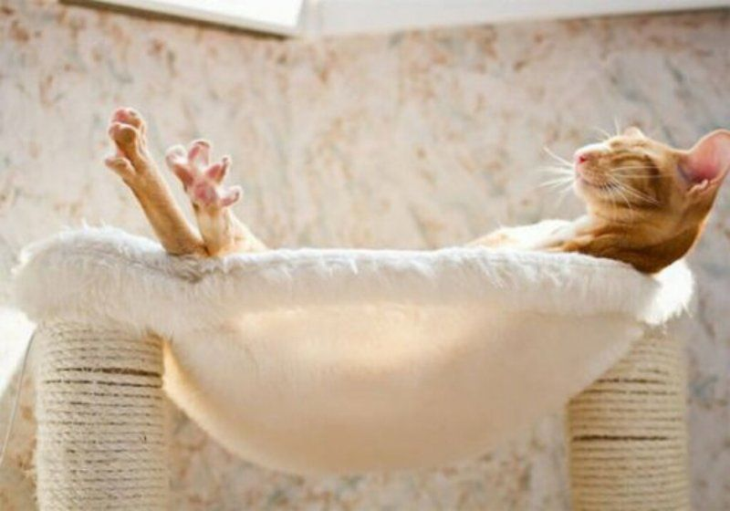
I always passed my exams successfully
I was never stressed out while preparing for my exams
I feel anxious about my children‘s health
FALSE
TRUE
FALSE

Slide 3

Stress management

Slide 4

Lesson aim
We are going to investigate a problem that is familiar to every 11 th grader - STRESS:
find out the causes, symptoms and the most effective ways to cope with stress

Slide 5
My typical day

Slide 6

Making a personal Stress Slice
Sleep
School
Homework and exam prep.
Social Media and Internet
Friends and family
Hobbies and free time

Slide 7
Making a personal Stress Slice

Slide 8
To experience stress
To be stressed out
To be under stress/pressure
To feel overwhelmed/unable to manage
To lose control/temper
To feel the strain of
To lighten the load
To feel anxiety/anxious
To be out of hand
In the run-up to exams

Slide 9
Let‘s talk
*This slice represents....
*The red part means that....
*I feel stressed when...

Slide 10
STRESSORS | SYMPTOMS AND EFFECTS | WAYS TO COPE WITH STRESS
School Exams

Slide 11
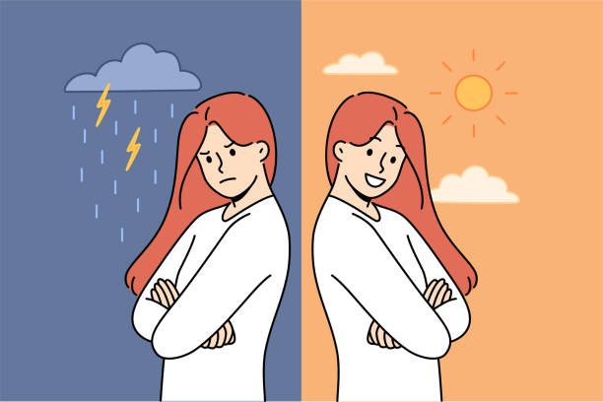

SYMPTOMS AND EFFECTS
The emotional and mental consequences
The physical body under attack

Slide 12

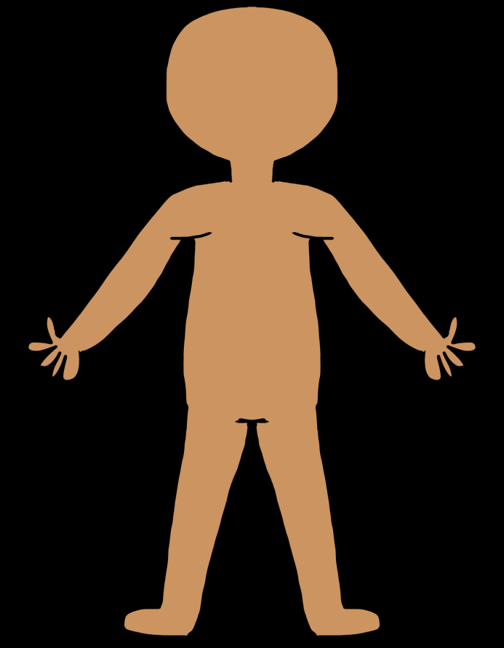
Physical symptoms
breathlessness
headaches
taut muscles
skin irritations
muscular twitches
frequent infections
fatigue

Slide 13
Emotional symptoms
Loss of confidence
Irritability
Depression
Apathy
Apprehension = fear
Restlessness
Insomnia
As for me, he most anxious emotional effect is...

Slide 14

Symptoms and Effects
Match the words with their definitions.
taut muscles
muscular twitches
headaches
skin irritations
fatigue
breathlessness
stressed out
frequent infections
a. A state of extreme physical or mental tiredness.
b. The feeling of being unable to breathe comfortably.
c. Conditions like acne or eczema that can be worsened by anxiety.
d. Feeling overwhelmed, anxious, and under pressure.
e. Aches in the head often caused by tension.
f. Muscles that are tight and not relaxed.
g. Getting sick (e.g., with a cold) often due to a weakened immune system.
h. Small, involuntary movements in the muscles.

Slide 15
While-listening
1) Listen to the text and write True (T)/ False (F) or Not Stated (NS)
Cortisol is released only during pleasant activities.
Muscular tension from stress often affects the back and shoulders.
Stress can improve the quality of your sleep.
Stress always leads to weight loss.
Emotional stress can damage relationships with close people

Slide 16


Slide 17
While-listening
1) Listen to the text and write True (T)/ False (F) or Not Stated (NS)
Cortisol is released only during pleasant activities.
Muscular tension from stress often affects the back and shoulders.
Stress can improve the quality of your sleep.
Stress always leads to weight loss.
Emotional stress can damage relationships with close people
False
True
False
Not stated
True

Slide 19
Listen to the text again and match the symptom or cause to their effect
Cause/symptom
1. Chronic stress
2. Constant muscle tension
3. Nervous system overload
4. Weakened immune system
5. Emotional exhaustion
Effect/description
a) Make you more prone to colds and flu
b) Leads to anxiety and irritability
c) Causes tension-type headaches
d) Keeps the "fight-or-flight" system active
e) Results in minor muscular twitches

Slide 20
Complete the chart with necessary words
relationships; muscular twitches; fatigue; neck, shoulders, back; frequent infections; irritability; motivation; skin irritations
Physical body
Emotional and mental state
Muscular tension: taut muscles in the (1)______, leading to headaches.Nervous system: (2)_____ in eyelids or hands.Energy and immunity: constant (3)_____ and more (4)_____.Skin and breathing: breathlessness and (5)_____.
Anxiety, (6)_____, difficulty concentrating. Loss of (7)_____. Strain on (8)_____ with friends and family.
neck,shoulders,back
muscular twitches
fatique
frequent infections
skin irritation
irritability
motivation
relationships

Slide 21

STRESS MANAGEMENT
Reading a text

Slide 22
STRESS MANAGEMENT
Read the statements and write T (True) or F (False).
___ The goal of stress management is to get rid of all stress from your life.
___ Exercise helps to release tension and improve mood.
___ Progressive muscle relaxation is a technique for dealing with tight, tense muscles.
___ Overcommitting and saying "yes" to everything is a good way to manage stress.
___ Sleep and nutrition have little impact on how your body handles stress.

Slide 23
STRESS MANAGEMENT
Read the statements and write T (True) or F (False).
__F_ The goal of stress management is to get rid of all stress from your life.
_T__ Exercise helps to release tension and improve mood.
__T_ Progressive Muscle Relaxation is a technique for dealing with tight, tense muscles.
_F__ Overcommitting and saying "yes" to everything is a good way to manage stress.
__F_ Sleep and nutrition have little impact on how your body handles stress.

Slide 24
STRESS MANAGEMENT
Find the Strategy.
1."I use a planner to break my big history project into smaller essays and tasks."
This is ________.
2."When I feel a panic coming on, I sit down and focus on my breathing: in for 4, hold for 7, out for 8."
This is activating the ________.
3."After a 30-minute jog, I always feel calmer and more positive, even if I was in a bad mood before."
This is using ________.
4."I make sure to call my best friend and just talk it out when I'm feeling overwhelmed." - This is using ________.

Slide 25
STRESSORS | SYMPTOMS AND EFFECTS | WAYS TO COPE WITH STRESS

Slide 26
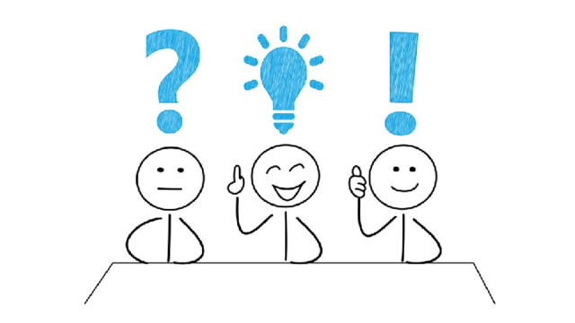
Reflexion
3 stressors I will fight with
2 symptoms of stress I will try to cope with
1 fact I‘ll share with my collegues

Slide 27
H/W
Create a “Stress Survival Guide” - retell,
learn new words

